Slide 1
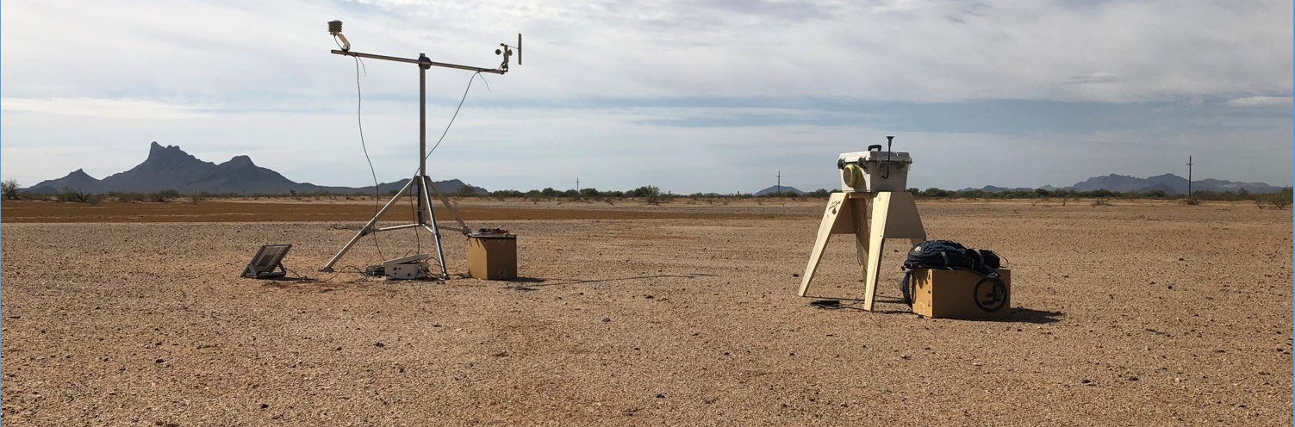




Use of Portable Dust Generator to Study Pichaco Peak Dust Storms
Arizona Space Grant Symposium 2019
HAS Superfund Laboratory
Presenter: Ruby O’Brien-Metzger
Mentors: Dr. Eric Betterton, Dr. Eduardo Saez, Kyle Rine
Funded By: NIEHS Superfund Research Program, NASA Space Grant Program

Slide 2
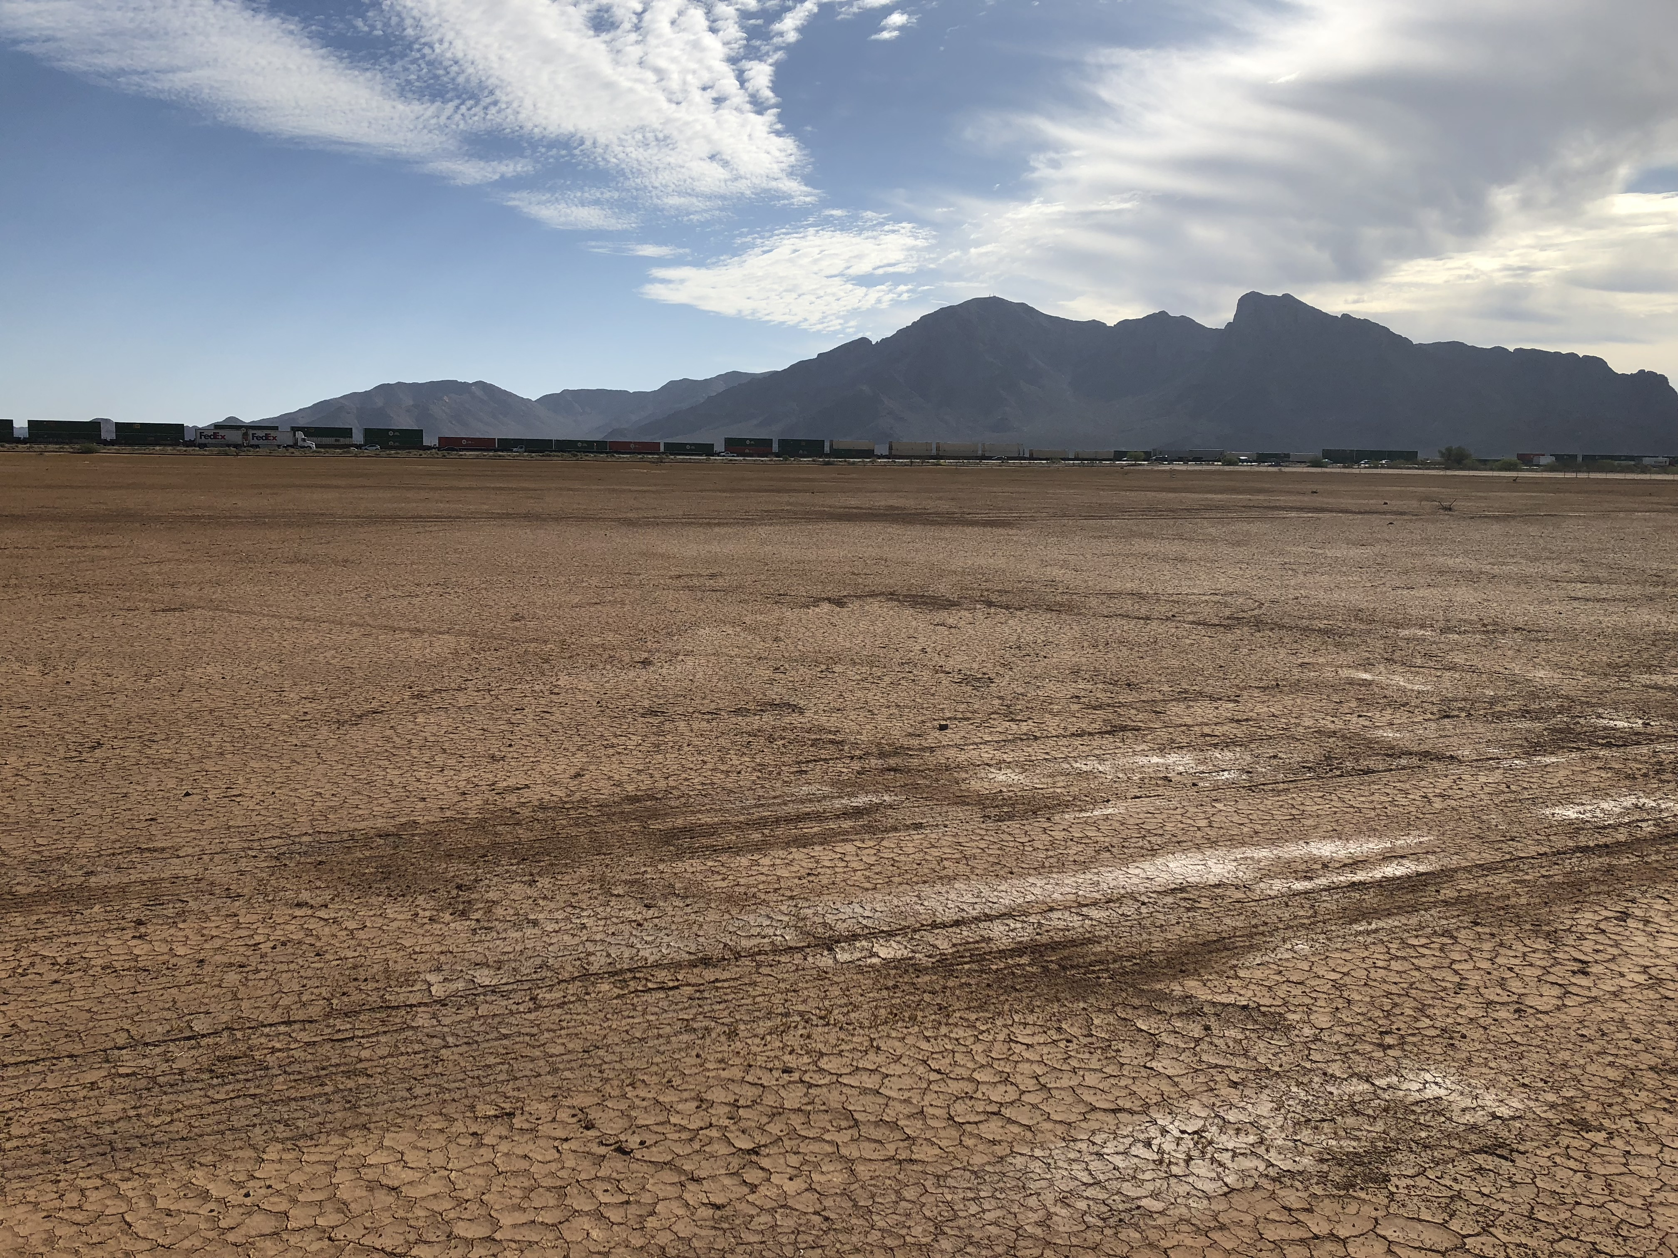
Research Objectives
Question: What wind conditions create dust storms?
Step 1) Create a known wind speed over a soil surface with portable wind tunnel
Step 2) Track how much dust is created from that wind speed

Slide 3
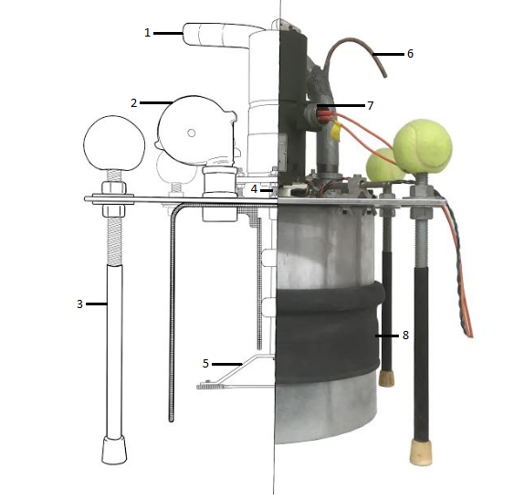
Portable Dust Generator
Based on PI-SWERL by DRI
Produces a known wind speed
Measures real time dust production
Lightweight and Compact
1. Exhaust Tube 2.Blower 3.Adjustable legs 4.Hall Sensor 5.Annular Ring 6.Isokinetic Sampling Port 7.Motor 8.Adjustable Skirt

Slide 4
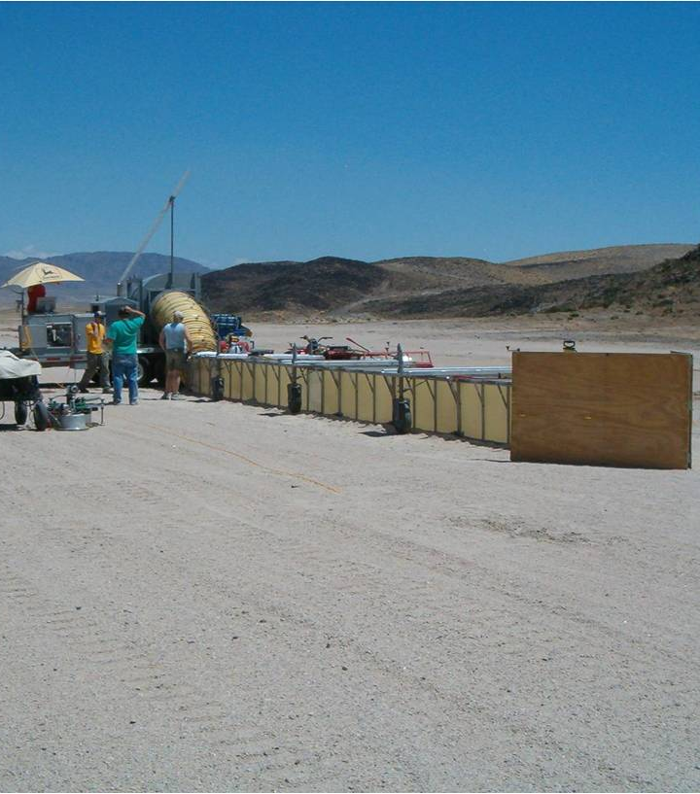
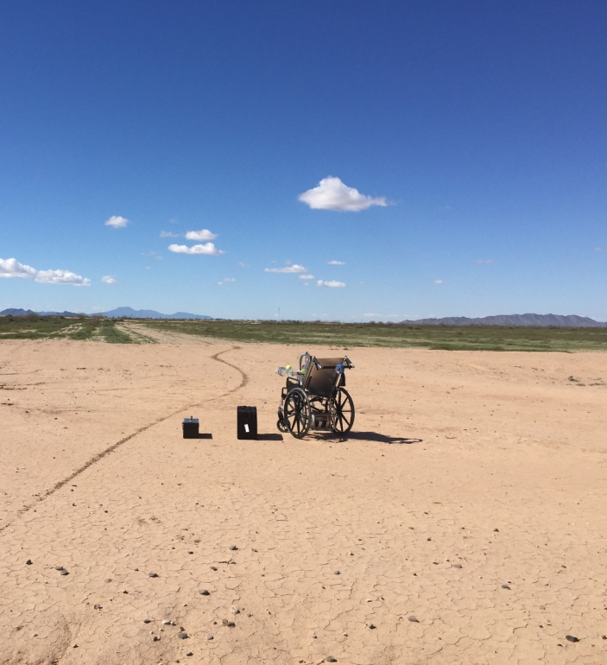
Lower Cost
Lower maintenance
Less man power required
Smaller foot print
Ease of use
Traditional Wind Tunnel
Portable “Wind Tunnel”
Photo Credit: Desert Research Institute

Slide 6
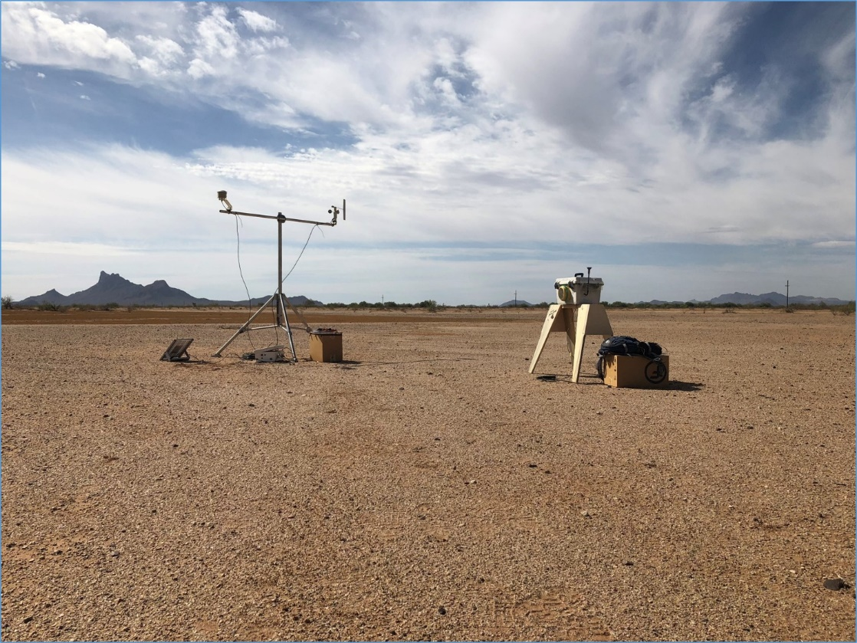
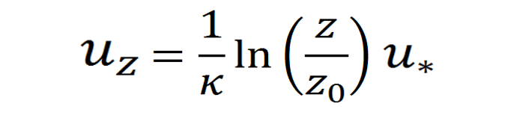
Picacho Peak 1-Day Study
Soil One (Crusted) TFV (u*) (m/s) 10-m Wind Speed (u_{z}) (m/s)
Run 1: 0.19 - 0.21 5.5 – 6.0
Run 2: 0.13 – 0.17 3.8 – 4.9
Run 5: 0.14 – 0.18 3.8 – 5.1
Soil Two (Rocky) TFV (u*) (m/s) 10-m Wind Speed (u_{z}) (m/s)
Run 3: 0.25 – 0.30 7.5 – 9.1
Run 4: 0.24 – 0.29 7.2 – 8.8
  u_{z}: Wind speed at height Z
  κ: Von Kármán constant (0.4)
  z_{o}: Roughness length
  u*: Friction velocity

Slide 7
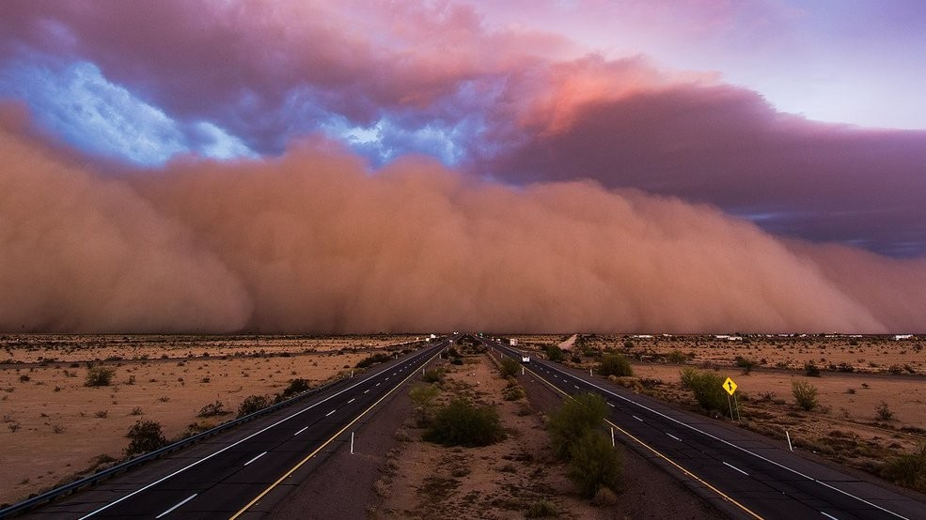
Future Work
More samples from Picacho Peak
Undisturbed sites
Wilcox area dust sources
Effects of soil moisture

Slide 8


